Slide 1








Waffo：All-in-One Global Payment Solution
1 API
Universal
162+
Areas
135+
Currencies
480+
Payment Methods
E-Wallets
Bank Transfers
QR Code
BNPL
Notes:
大家好，欢迎参加今天的演示。今天我将向大家介绍Waffo，一个致力于为全球企业提供一站式支付解决方案的平台。
我们的核心优势在于通过单一API，即可触达全球超过162个地区，支持135+种货币以及480多种支付方式。这意味着您无需为不同国家的支付接入烦恼，一次集成，即可覆盖全球主流市场。
具体来说，我们支持电子钱包、银行转账、二维码以及BNPL（先买后付）等多种流行的支付方式，充分尊重当地用户的支付习惯，从而提升您的转化率。
无论您的业务在哪里，Waffo都能帮助您轻松实现全球收款，助力业务增长。谢谢大家。

Slide 2
Products & Solutions
A merchant-growth-focused global monetization platform, handles global payments, taxes, subscriptions, and compliance—empowering businesses from solo founders to global enterprises.
Core Products
Industry Solutions
Billing System
Subscription Management & Invoicing
AI & SaaS
Simplify SaaS payment stack for recurring revenue
Payment Processing
Global Payment Gateway & Local Acquiring
Gaming Industry
Seamless monetization for game developers
Growth Accelerator
Merchant of Record & Fraud Protection & Optimization
Online Applications
Optimized payment flows for web & mobile apps
Notes:
接下来，让我们概览一下Waffo的产品与解决方案。我们是一个专注于商户增长的全球货币化平台，提供支付、税务、订阅和合规的全方位服务。我们的产品体系主要分为两大部分：核心产品和行业解决方案。核心产品包括计费系统、支付处理和增长加速器。而行业解决方案则针对AI与SaaS、游戏以及在线应用等特定领域，提供定制化的支付策略。

Slide 3

Core Product Modules
01 / BILLING
Flexible Subscription Management
Professional Invoicing System
02 / PAYMENTS
Global Instant Payments
Customizable Checkout Experience
03 / GROWTH
Merchant of Record Service
Success Rate Optimization
Advanced Fraud Protection
Comprehensive Financial Ecosystem
Notes:
具体来看，我们的产品可以归纳为三大核心模块。首先是计费模块，涵盖了灵活的订阅管理和专业的发票系统。其次是支付模块，提供即时支付和高度可定制的结账体验。最后是增长模块，通过记录商户服务、成功率优化和欺诈保护，为您的业务增长保驾护航。这三大模块共同构成了Waffo强大而全面的产品矩阵。

Slide 4
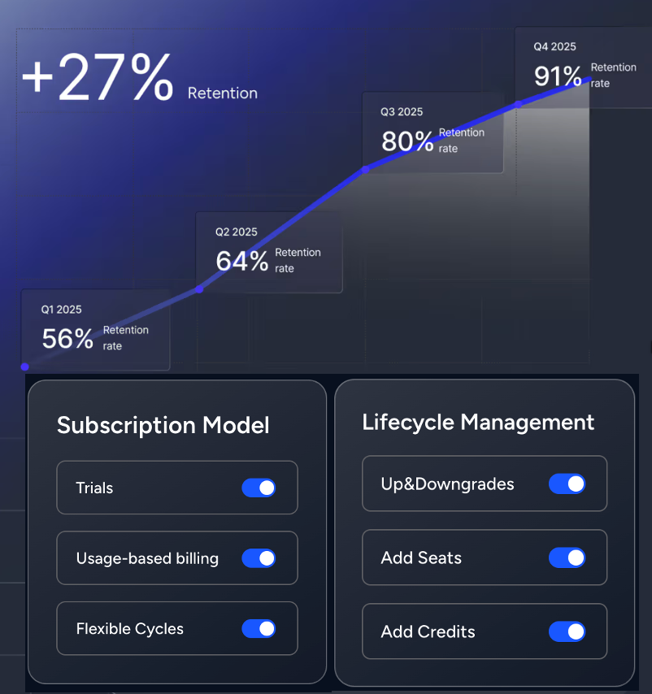
Subscription Management
Flexible Billing Models
Trials, usage-based billing, add-ons & flexible cycles to maximize LTV.
Full Lifecycle Control
Seamlessly handle upgrades, downgrades, seat adjustments, and credit modifications.
Conversion & Retention Boost
Custom checkout flows streamline payments.
Smart renewal reminders reduce churn.
Waffo Subscription Dashboard
Notes:
首先深入了解我们的订阅管理功能。Waffo为您提供无与伦比的灵活性，支持试用、按量计费、附加组件和灵活的计费周期，帮助您轻松提升客户终身价值。我们能无缝处理订阅生命周期中的各种变更，如升级、降级、增减席位等。更重要的是，通过优化结账流程和自动化续费提醒，我们能有效提升转化率和客户留存率。

Slide 5
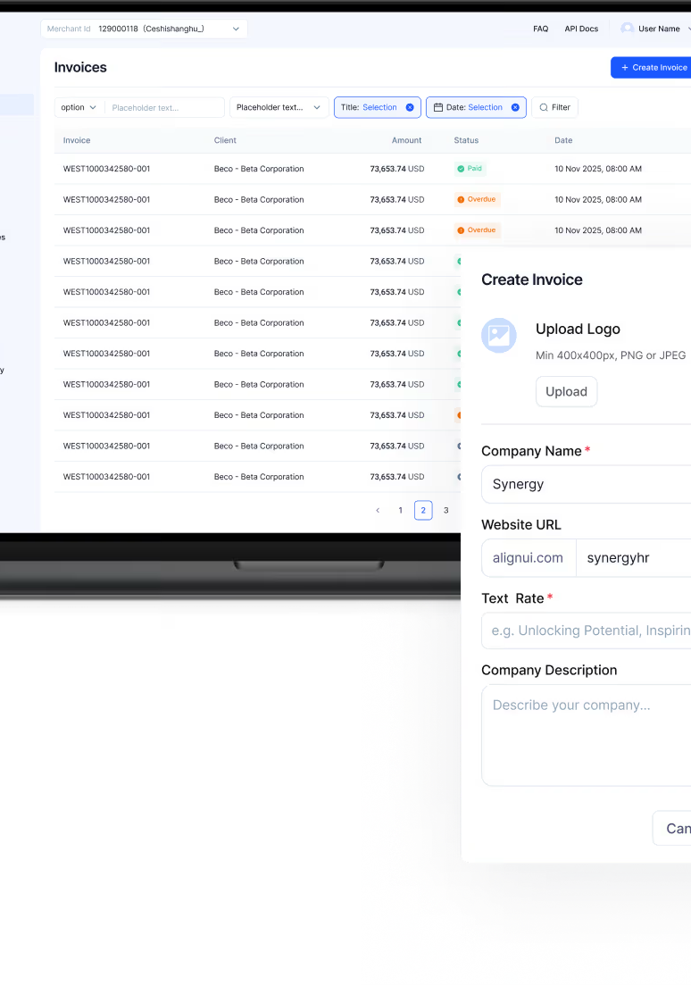
Invoicing
Create professional invoices in minutes and automate your entire accounts receivable workflow. With Waffo, you can issue invoices in 135+ currencies and let customers pay via their preferred local methods—all built-in compliance.
Built-in Tax Compliance
Waffo handles sales tax, VAT calculation, and remittance automatically for every service you send.
Optimized for B2B Payments
Support high-value transactions via local bank transfers, ACH, and SEPA, in addition to global cards and wallets.
Zero-Touch Reconciliation
Incoming payments are automatically matched to issued invoices in real time, keeping your books perfectly balanced.
Accelerated Payment (DSO)
Customers pay instantly without logging in, significantly reducing your Days Sales Outstanding.
Waffo Invoicing Dashboard Preview
Notes:
接下来是我们的发票功能。您可以在几分钟内创建专业发票，并自动化整个应收账款流程。我们支持135多种货币，并内置税务合规功能，自动处理销售税和增值税。针对B2B支付，我们优化了本地银行转账等大额交易方式。更重要的是，我们的零接触对账功能能实时匹配付款与发票，大幅降低您的销售未清天数（DSO）。

Slide 6
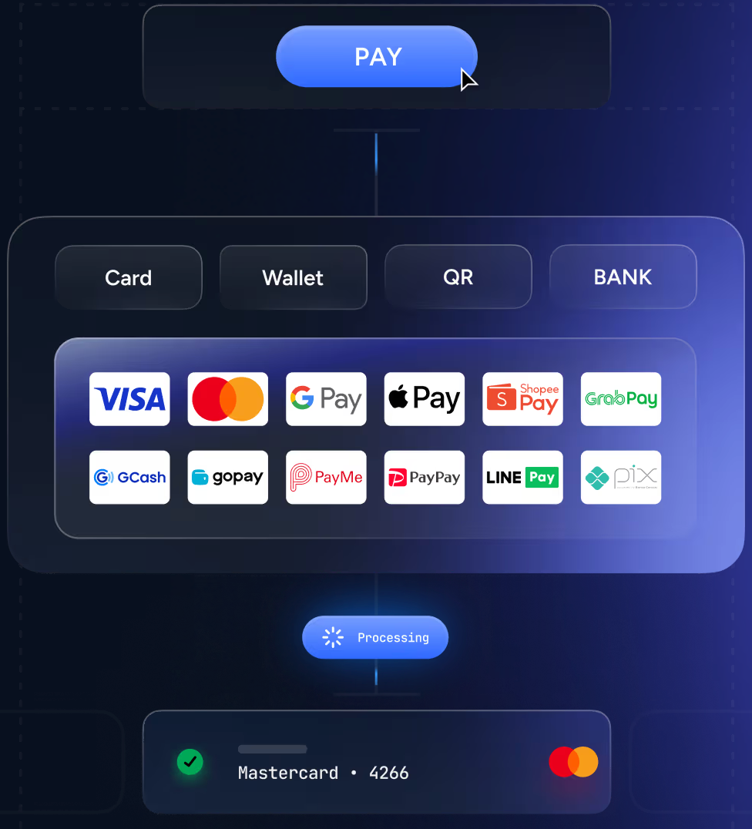
Instant Payments
Global Integration Overview
Seamless integration covering 162+ Regions & 480+ payment methods.
● One API, global reach
Integrate once to access payments across 162+ regions worldwide.
● No local entities required
Enter new markets without complex local compliance setup.
● Local Currency Support
Display prices and receive payments in the user's local currency.
● Direct Local Acquiring
Direct channel connections optimize UX, success rates & pricing.
Notes:
现在我们来看支付模块。Waffo的即时支付功能，让您通过一次集成，就能覆盖全球162个地区和480多种支付方式。您无需在当地设立实体，即可轻松进入新市场。我们支持以本地货币显示和支付，并通过直连本地收单渠道，为您的用户提供更流畅的体验、更高的成功率和更优的定价。

Slide 7
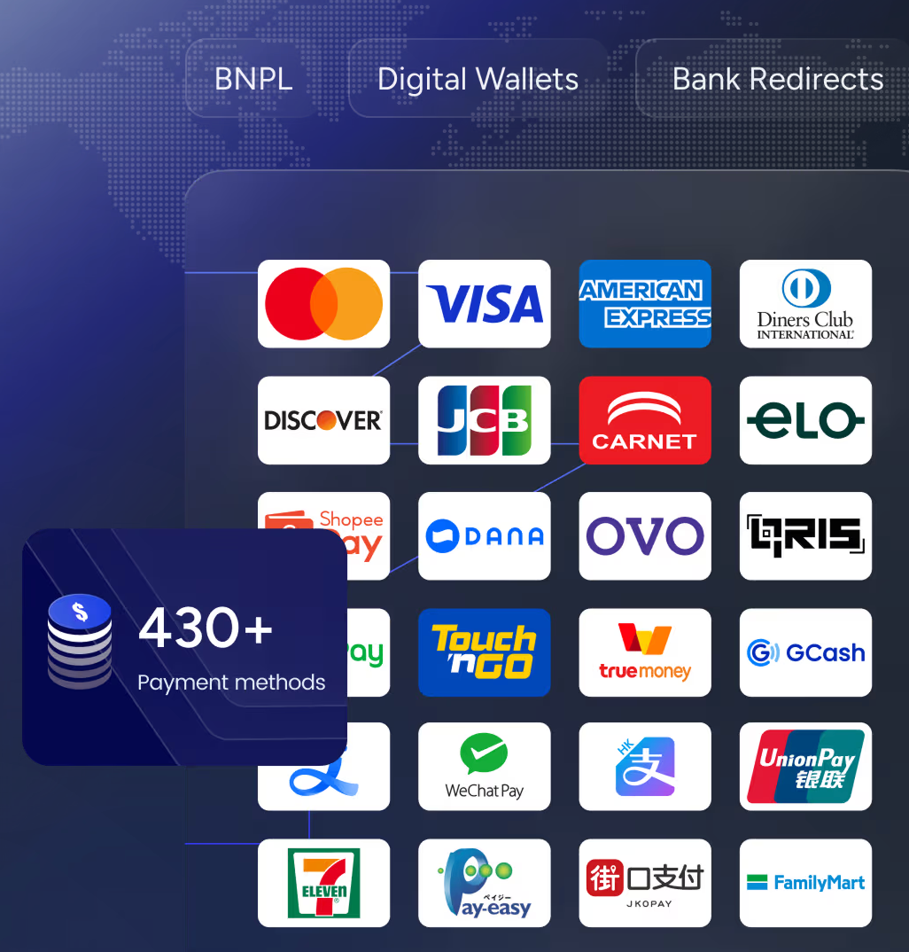
Checkout
Waffo checkout delivers a high-converting, fully customizable payment experience. Turn on new markets instantly without building separate integrations.
480+ Payment Methods
Don't let missing options cost sales. Offer global cards, local wallets, and bank transfers for every customer.
Built for Conversion
Reduce friction with address auto-complete, real-time card validation, and instant loading on any device.
Full Customization
Match your brand perfectly—adjust colors, fonts, and shapes for hosted or embedded checkouts.
Smart Localization
Auto-adapt to customer location for local language, currency, and trusted payment methods to boost acceptance.
One Dashboard for Global Reach
Notes:
我们的结账页面是提升转化率的关键。它不仅支持超过480种支付方式，确保您不会因为支付选项缺失而丢失订单，还通过地址自动填充、实时卡片验证等功能减少用户摩擦。您可以完全自定义结账页面的外观，使其与您的品牌完美融合。同时，智能本地化功能会自动适配用户的语言、货币和支付习惯，显著提升支付成功率。

Slide 8




Merchant of Record: A Powerful Engine for Global Business Growth
Global Tax Compliance
Automatically handles global tax compliance, including VAT, GST, etc., freeing you from tedious tax declaration processes.
Localized Checkout
Supports multiple global languages, currencies, and payment methods, automatically adapting to significantly boost payment conversion rates for global consumers.
Stop Churn
Intelligently retries failed payments, automatically updates cards and sends reminders, proactively recovering customers before churn to stabilize your recurring revenue.
Chargeback Protection
We assume the risks of payment failures, fraud, and disputes for you. Our professional team handles disputes on your behalf, ensuring your revenue remains stable and reliable.
Notes:
接下来是我们的增长模块，首先是记录商户（Merchant of Record）服务。这项服务能让您实现全球税务合规的自动化，无需再为VAT、GST等税种烦恼。通过提供本地化的结账体验，我们能有效提升转化率。我们的智能重试系统能自动挽回失败的付款，防止客户流失。最重要的是，我们为您承担支付失败、欺诈和拒付带来的财务风险，让您的收入更加稳定可预测。

Slide 9
Success Rate Optimization
Waffo Success Rate Optimization is an intelligent payment routing and retry system that improves authorization rates by up to 15%. Our proprietary AI-powered routing engine analyzes, routes, and retries transactions in real time.
● Comprehensive Success Reports & Root Cause Analysis
Standard reports only show 'what' happened? Waffo tells you 'why.' We break down Payment Success vs. Checkout Conversion and identify root causes—like bank restrictions—with user-friendly cycles, significantly increasing renewal rates for insufficient fund.
● Global Edge & Emergency Routing
Speed equals conversion. Our global nodes cut load times to 0.9s. Smart multi-MID routing instantly switches to backup channels if risks are detected, ensuring your business never stops due to downtime.
● Maximize Subscription Revenue
AI-Driven Smart Retries: Timing is everything for recurring billing. Instead of blind retries that trigger fraud alerts, Waffo analyzes failure codes and retries with user-friendly cycles, significantly increasing renewal rates for insufficient fund.
● Merchant of Record (MOR) & AVS
Cross-border payments often fail due to lack of trust. Waffo connects you to local entities and utilizes Address Verification Service (AVS) to provide strong local trust signals, boosting first-time authorization rates by over 5%.
Notes:
我们的成功率优化功能，是一个由AI驱动的智能路由和重试系统，能将授权率提升高达15%。我们提供全面的成功报告和根本原因分析，帮助您了解支付失败的真正原因。通过全球边缘节点和应急路由，我们确保支付流程的极致速度和稳定性。针对订阅业务，我们的智能重试机制能显著提高续费成功率。同时，结合记录商户服务和地址验证，我们能有效提升跨境支付的首次授权率。

Slide 10
Fraud Protection
Waffo Fraud Protection is an AI-powered real-time fraud detection and chargeback management system. It detects and blocks fraudulent transactions using an engine that continuously learns from your unique transaction patterns.
AI-Powered Precision
Our machine learning models train on a vast global payment network, adapting to shifting fraud patterns instantly, identifying risks with greater accuracy than third-party solutions.
Automated Dispute Management
Say goodbye to manual paperwork. Automatically generate evidence and submit responses to issuers, boosting your dispute win rate and operational efficiency.
Frictionless Experience
Dynamically apply 3D Secure only for high-risk transactions. Reduce false positives and let legitimate customers checkout in seconds without unnecessary hurdles.
Detect fraud before it happens
Advanced Machine Learning leverages device fingerprinting, behavioral analytics, and historical snapshots to assign a multi-dimensional risk score to every transaction.
Your business, your rules
Customizable Risk Logic: Use our visual editor to set precise rules, create allow/block lists, and define triggers for 3D Secure verification based on your needs.
Win more disputes on autopilot
Instant Evidence Generation: Waffo's AI analyzes history to pre-fill the strongest evidence and predicts win probability when chargebacks occur.
Protection built into the flow
Integrated natively with Waffo Checkout (no extra API calls). Adaptive 3D Secure challenges users only when necessary to keep conversion high.
Notes:
最后，是我们强大的欺诈保护系统。它由AI驱动，能够实时检测和阻止欺诈交易。我们的机器学习模型在庞大的全球支付网络上训练，能比传统方案更精准地识别风险。我们实现了争议管理的自动化，大大提升您的拒付胜诉率和运营效率。通过动态应用3D安全验证和先进的机器学习技术，我们在保护您的同时，确保了真实用户的流畅体验。您还可以自定义风控规则，实现真正的个性化保护。

Slide 11



Waffo Solutions: Empowering Global Growth
Tailored payment infrastructure for AI, Gaming, and Online Applications
AI & SAAS
Gaming
Online Apps
Waffo is a payment infrastructure and Merchant of Record platform built for AI/SaaS. Covering 480+ payment methods across 162+ countries, we maximize conversions while handling tax, compliance, and risk.
Support high-volume in-game purchases with local payment methods, localized pricing, and stable checkout flows. Optimized to maximize conversion during live games and peak traffic.
Helps online apps monetize through controllable third-party checkout and broader local payment access. Drives higher first-time conversion and renewal rates globally.
Global Payment Solutions for Every Industry · 162+ Countries Covered
Notes:
在了解了我们的核心产品之后，让我们看看Waffo针对不同行业的解决方案。我们为AI与SaaS公司提供强大的支付基础设施和记录商户服务，让您专注于业务增长。针对游戏行业，我们支持高并发的游戏内购买和充值，并优化了本地化支付和定价。对于在线应用，我们通过可控的第三方结账和更广泛的本地支付接入，帮助您在全球范围内提升转化率和续费率。

Slide 12
AI & SAAS
AI founders' headaches: Core Challenges in Global Expansion
1. Compliance (Global & Legal)
2. Acquisition (User Growth)
• High complexity of global tax regulations
• Cumbersome KYB documentation requirements
• Risks of blocked accounts and frozen funds
• Low success rate for first-time subscription payments
• Inability to support localized pricing strategies
• Unclear payment failures causing drop-offs
3. Payment Provider Limitations
4. Retention (Customer Loyalty)
• Limited payment success rate analysis
• Hidden fees and lack of transparent pricing
• Slow customer support response time
• Interrupted recurring payments due to declines
• Lack of visibility into customer churn data
• Inflexible plans (no support for upgrades/downgrades)
Notes:
首先来看AI与SaaS行业。创始人通常面临四大痛点：第一，全球税务合规的复杂性和繁琐的合规要求；第二，新用户获取难，首次订阅支付成功率低，且缺乏本地化定价策略；第三，传统支付提供商功能有限，缺乏透明的费用和有效的成功率分析；第四，客户留存难，续费流程不畅，且缺乏有效的用户流失数据分析。

Slide 13




AI & SAAS
How Waffo Helps You Win
Grow faster by not building payments
Unlock More Ways to Subscribe Globally
Handles global tax, compliance, invoicing, settlement, and chargebacks so your team stays focused on growth.
Support subscriptions via cards, wallets, and flexible billing models to boost global conversion and renewals.
Protect every dollar
Integrate faster, launch globally
Real-time fraud detection and automated dispute handling safeguard revenue and reduce leakage.
Launch a localized, high-converting checkout in minutes with minimal engineering effort.
Notes:
针对这些痛点，Waffo提供了四大制胜法宝。首先，我们帮您处理所有支付相关的合规、税务和结算问题，让您的团队能专注于核心业务增长。其次，我们解锁全球订阅方式，支持各种支付工具和灵活的计费模型。第三，我们通过实时欺诈检测和自动化争议处理，保护您的每一分收入。最后，我们提供快速集成方案，让您能在几分钟内部署一个本地化的、高转化率的结账页面，迅速走向全球。

Slide 14
Gaming
04
Why global gaming revenue breaks at scale
1. Local payment expectations vs. blockages
2. Operational cost of global scaling
•Players drop off when local wallets are not supported
•Card-only checkout underperforms outside core markets
•Hesitation when familiar local payments are unavailable
•Local entities are required to unlock regional payments
•Fragmented integrations slow launches and operations
•Low volume leads to higher processing fees
3. Increased "friendly fraud" risk
4. Payment weaknesses under peak traffic
•High transaction volume invites abuse and disputes
•Generic rules block good players or miss real threats
•High chargeback rates trigger account restrictions
•Payment failures spike during launches/events
•Checkout instability kills conversion under load
•Lack of real-time visibility into failed payments
Notes:
接下来是游戏行业。为什么全球游戏收入在规模化时会遭遇瓶颈？主要有四个原因：第一，玩家期望使用本地支付方式，但常常被拒绝；第二，全球支付扩展带来高昂的运营成本和复杂的集成；第三，游戏业务容易吸引“善意欺诈”，通用的风控规则难以平衡安全与体验；第四，峰值流量会暴露支付系统的弱点，导致支付失败率飙升。

Slide 15
Gaming
05
How Waffo Helps You Win
1. Trusted Payment Methods
2. Local Ecosystem Growth
Enable purchases across 162+ regions and 480+ local payment methods. Present familiar options to build trust and boost global conversion.
Acquire players via top local wallets. Place your game in pop-ups and banners where users already engage for precision traffic.
3. Robust Peak Traffic Checkout
4. Intelligent Revenue Protection
Ensure stable checkout during launches or promotions. Maintain reliability when concurrency and revenue impact are at their highest.
Apply game-aware risk controls and automated dispute handling to reduce fraud and chargebacks, ensuring legitimate players transact smoothly.
Notes:
Waffo如何帮助游戏开发者赢得成功？首先，我们通过一次集成，让玩家可以使用他们信任的480多种本地支付方式进行购买。其次，我们通过与主流本地钱包合作，帮助您精准获取用户。第三，我们的结账系统专为峰值流量设计，确保在游戏发布或促销期间保持稳定可靠。最后，我们应用游戏感知的风控策略，在保护收入的同时，确保真实玩家的流畅体验。

Slide 16
Online Apps
Why online app revenue breaks at scale
1. In-app checkout flexibility is limited
2. High chargeback rates create hidden risk
- Local payment methods cannot be added
- Checkout flows cannot be adjusted to product needs
- Pricing and fee structures are fixed and inflexible
- Disputes erode revenue and margins
- Elevated chargebacks trigger account restrictions
- Handling chargeback evidence is cumbersome
3. First-time conversion is opaque
4. Renewal revenue is fragile
- Checkout success rate is a black box
- No complete success rate analysis reports
- Teams cannot optimize what they cannot see
- Excessive cancellation reminders disrupt UX
- Failed renewals silently interrupt revenue
- Expired cards and retries are poorly handled
Notes:
最后我们来看看在线应用行业。在线应用的收入在规模化时同样面临挑战。第一，应用内结账的灵活性有限，难以添加本地支付方式和调整流程。第二，高拒付率带来了隐藏的风险，侵蚀了收入和利润。第三，首次转化率是个黑盒，缺乏有效的分析工具来进行优化。第四，续费收入非常脆弱，失败的续费和过期的卡片处理不当，会造成大量收入流失。

Slide 17
Online Apps
How Waffo Helps You Win
1. Fully customizable checkout flows
2. Success rate optimization
Easily integrate local payment methods and adjust payment processes to meet your app's unique needs.
Unlock actionable insights and optimize payment performance with complete success rate analysis.
3. Protect and enhance renewals
4. Keep chargeback rates under control
Automated retry logic and seamless expired card management help improve long-term retention.
With fraud detection and automated dispute handling, protect revenue while reducing manual intervention.
Notes:
Waffo为在线应用提供了四大解决方案。第一，我们提供完全可定制的结账流程，让您能轻松集成本地支付方式。第二，我们的成功率优化功能提供可操作的洞察，帮助您提升支付表现。第三，我们通过自动化的重试逻辑和过期卡片管理，保护并提升您的续费收入。第四，我们通过欺诈检测和自动化争议处理，将拒付率控制在合理范围内，减少人工干预，保护您的收入。

Slide 18











How is Waffo different?
Waffo: Your Growth Partner
Other Payment Providers
MOR Service Tax & compliance handled for you
Self-Service No help on tax & compliance
Optimization Failure analysis + Targeted fixes
Basic Reporting No deep analysis for improvements
Local Support Fast, In-language help for growth
Slow Support Delayed replies, English-only
Smart Pricing Pay only for successful transactions
Hidden Fees Blended rates & unexpected charges
Notes:
总结一下，Waffo与其他支付提供商有何不同？我们不仅仅是一个支付工具，更是您的增长伙伴。我们提供专业的记录商户服务，处理繁琐的税务合规；我们提供深度的失败分析和优化建议；我们提供快速的本地化语言支持；我们采用智能定价，您只需为成功的交易付费。相比之下，其他提供商往往是自助服务，报告功能基础，支持缓慢且常有隐藏费用。选择Waffo，就是选择一个更可靠、更专注于您业务增长的合作伙伴。谢谢大家。

